Slide 1
Lesson 2: Memory, Lists, and Loops
How is computer memory managed?

Slide 2
Recap
Features of a programming language
  Keywords, functions, operators, etc
  Arithmetic operations (+,- , *, /, pow)
  Variables (x = 5),
  Strings (“hello”)
But how does the computer do any of this stuff?

Slide 3
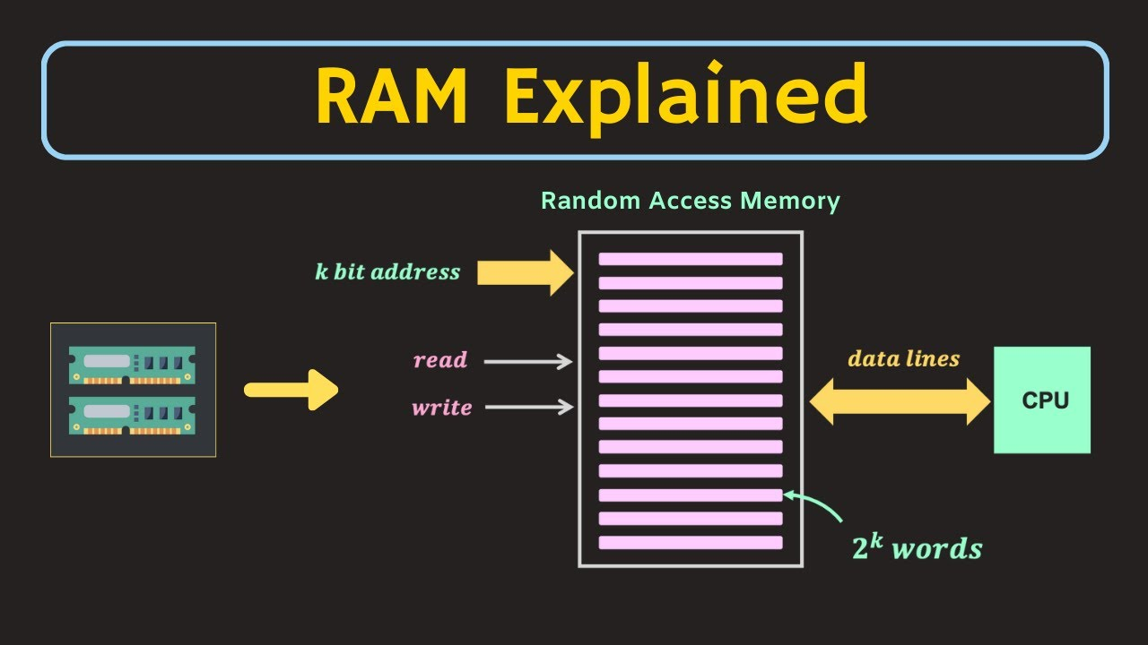
Memory
Variables need to exist even after they’re declared
They must be remembered somewhere
This is the purpose of your computer’s RAM
Every physical position on your ram is an address
Your operating system is a real-estate agent
It provides RAM addresses to processes as needed

Slide 4
Memory Regions
There are two OS-Provided memory regions:
  The Stack and the Heap
The stack is small, simple and humble
The heap is large, complex and greedy

Slide 5
Memory Regions: The Stack
Handles program instructions and simple variables
Allocations are made one after another, no gaps
Responsible for managing scope
  Anything that goes “out of scope” is cleared off the stack
In all languages the stack is managed automatically
Things the compiler knows are allocated on the stack

Slide 6
Memory Regions: The Heap
Designed for allocations of various size
It’s like a big cloud of memory, filled with gaps
Why? Because the programmer controls when memory is freed
Python Lists are on the Heap!!

